Slide 1
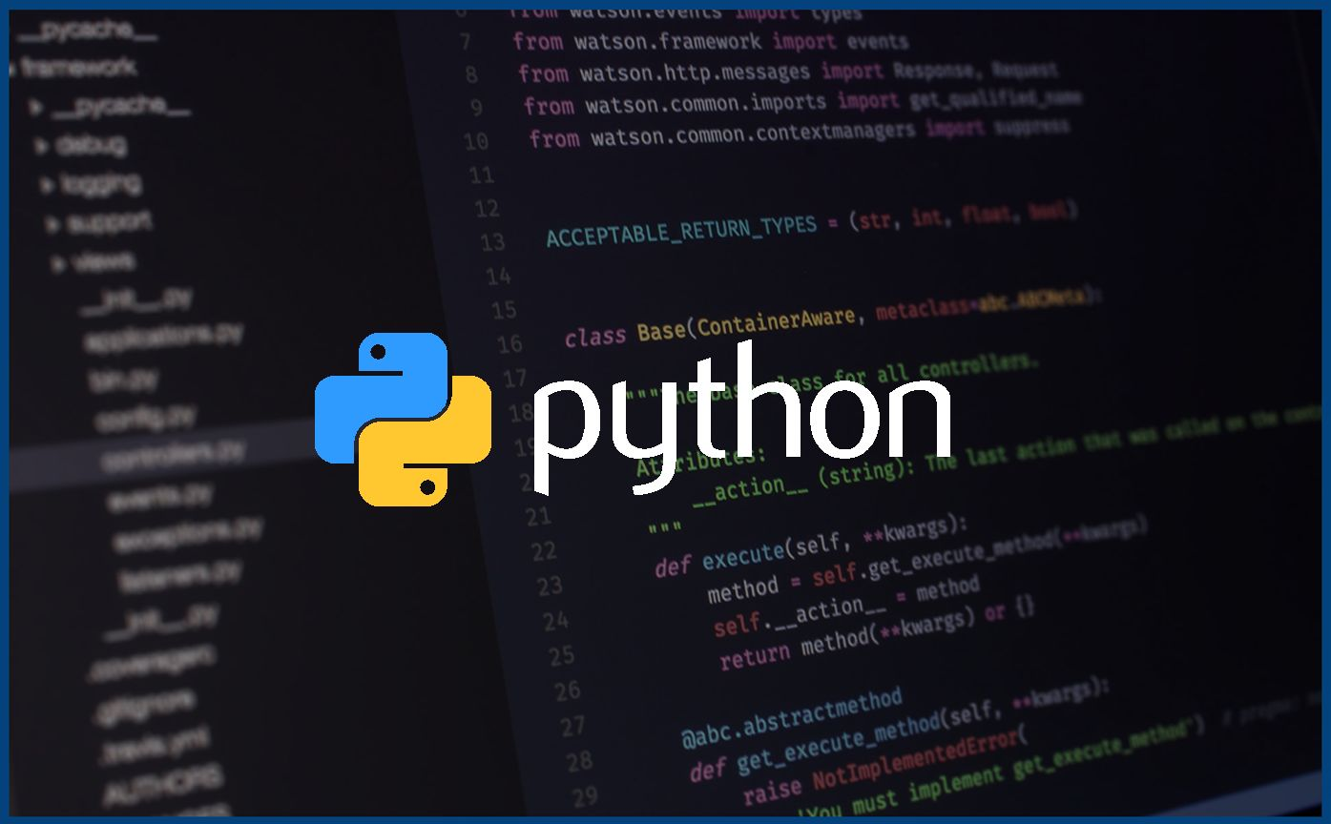
Fundamentals of Programming Using Python
This Photo by Unknown author is licensed under CC BY-SA-NC.

Slide 2

Expression
An expression in Python is a logical grouping of the operators and operands which gives a specific output.
Ex.
>>> a = 10
>>> b = 11
>>> 3*a+b-a+2*b

Slide 3
Precedence of Operators
When operators are used along with other operators, then the precedence of the operator decides which operator will be executed first.
This operator precedence is extremely important in expression evaluation.

Slide 4
eval() function
If an expression is in the represented in the form of a string, then we can use eval() to evaluate the result of the expression.
Ex.
>>> a = "10+39*3"
>>> eval(a)
127

Slide 5
User Input
In Python, You can take user input using the input() function.
This function returns the value entered by the user as string datatype.
Ex.
>>> a = input();
>>> b = input("Enter Now:")

Slide 6
Control Flow
The execution and flow of a program in any programming language can be broadly classified into three categories.
Sequence
Selection/Decision
Iteration/Looping

Slide 7
Control Flow Statements
These are statements which control the flow of the execution of a program.
Conditional Statements.
Iterative Statements.

Slide 8
Flow Charts
Flow charts are an immensely powerful way of easily representing execution of a program.
In Flow Charts, we use different shapes and indicators to represent essential parts of a program.

